Slide 1
Building a competition robot
Seshan brothers

Slide 2
Our Rules for ROBOT Design
RULE #1: Take your time to build your base robot before jumping into attachment building and solving missions.
RULE #2: If you are just starting out, it is okay to start with a solid base robot design from someone like LEGO, EV3Lessons, or a book. Don’t start with a robot designed for maximizing points at a contest. Instead, start with a basic design (not made for a competition) that you can add on to so that your team can discover on their own. Be sure you cite the source for your design/strategy ideas.
RULE #3: Take time to test your own ideas rather than seeking the “Internet Solution”. As you progress through FLL, you will develop your building skills and develop your own style. Don’t take shortcuts and skip steps in the learning process.

Slide 3
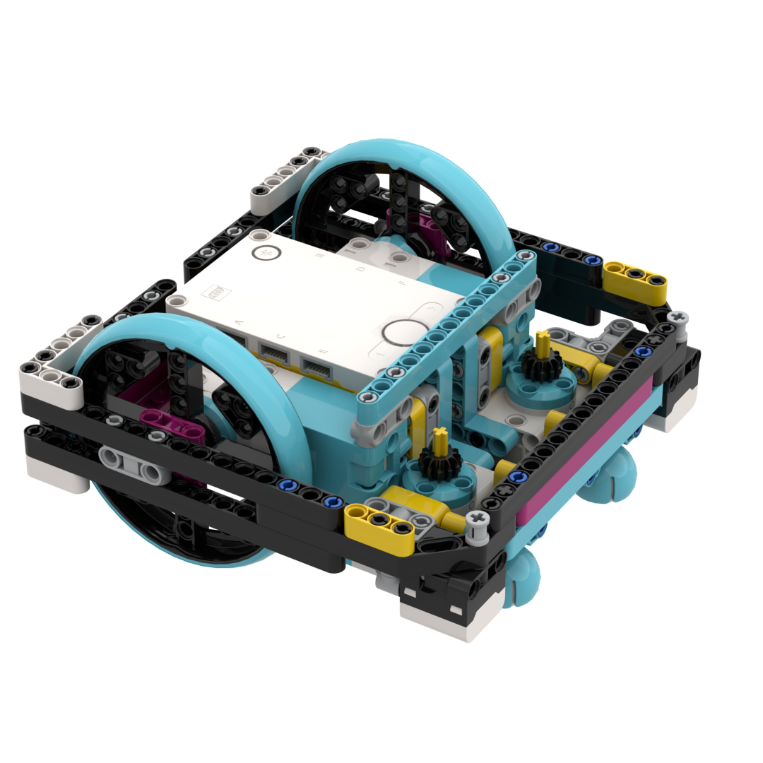
DESIGN CONSIDERATIONS
In the next few slides, we present some key questions you need to ask yourself before building a competition robot
You should consider the pros and cons of each option
We firmly believe that you should design and test ideas for yourself – there is no perfect wheel or perfect design for a competition
We discuss the following 6 factors: Size, Weight/Balance, Sensors & Placement, Arm Motor Placement, Wheel Choice and Other

Slide 4
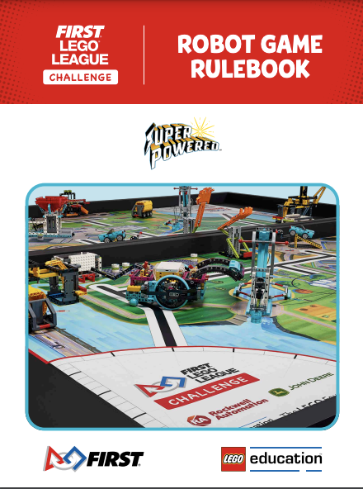
Height & Width
Always check for any height limitations set by the rules
There may be other height limitations caused by the size, shape and location of a mission model (e.g. you may have to go under a bridge)
Consider width restrictions caused by Launch dimensions and narrow openings in the challenge mat

Slide 5
balance
Questions to ask yourself: Is your robot well balanced? Is the center of gravity in the right location?
The robot should not be weighted to any one side
If it does, your moves will be unreliable, the tires may skid, the robot may veer
Once you add the weight of the attachments, this may worsen.
Carefully consider the placement of the brick and also the weight of the attachments
A brick placed too high might be top heavy. A brick placed too much towards the front or back makes the robot imbalanced

Slide 6
Sensors And their placement
What sensors do you need to add to accomplish your team’s goals?
Where should the sensors be placed?
Color sensors need to be a good distance from the drive wheels to line follow. Sometimes placing them too close to the wheel causes problems with the line follower.
The gyro can be placed anywhere but must face a certain direction to be used to measure turns.
The other sensors need to be placed where they are most useful - on the side of the robot where you will use them the most.

Slide 7
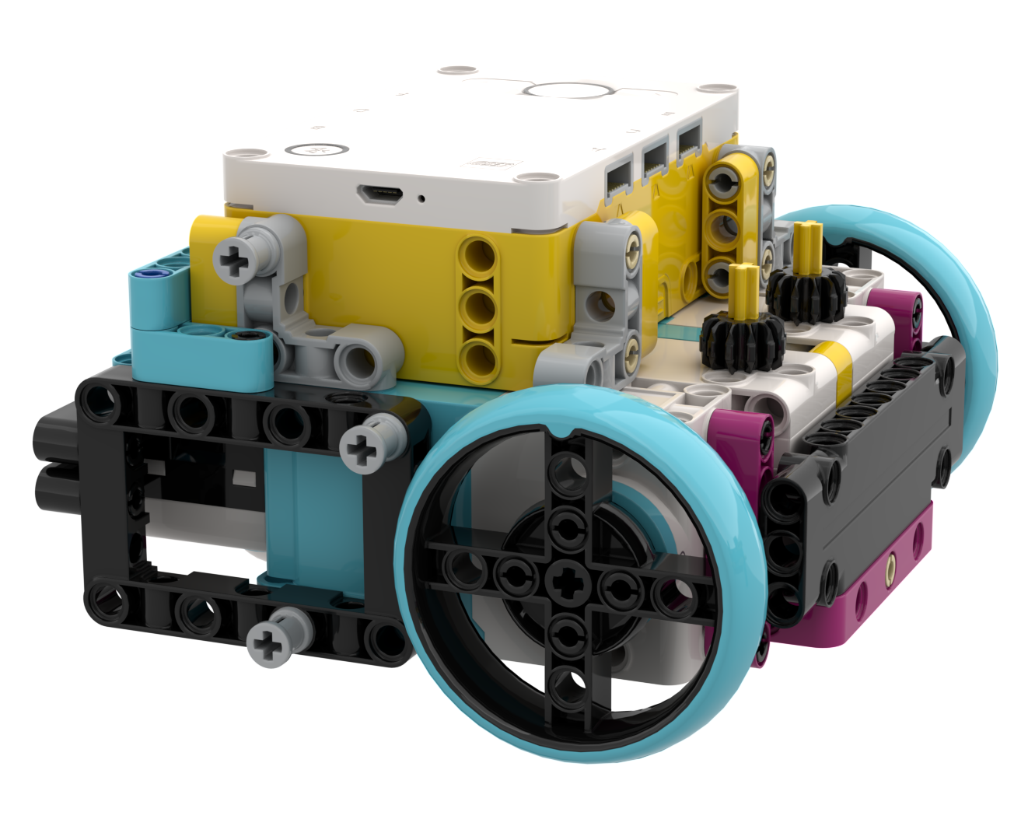
ARM Motor placement
If you are using the EV3 or SPIKE Prime, you can use 2 additional motors (of any type). You need to decide if you like the Medium or Large Motor.
Where you place them depends on the attachments you build and if you are willing to add gears to your attachment
Do you have to do a task up high or low to the mat?
Will you be able to add attachments to the motor quickly and easily?
Is the robot still balanced after adding the extra motors?

Slide 8
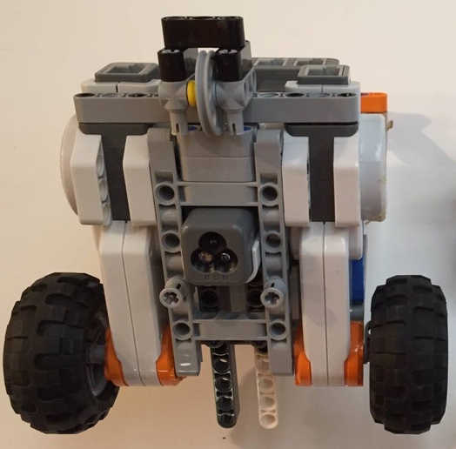
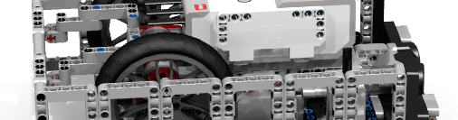
Wheels
Don’t listen to anyone who tells you which wheels are best for FIRST LEGO League. Every robot is different. Every year of the contest is different.
Always do your own tests to determine which wheel is best for your particular robot and what the tradeoffs are
Larger wheels may be faster, but are less precise and have more slack
Small wheels are slower, but sometimes are more precise
Firmer tires won’t become out of shape or come off the rims.
Back wheels/skids need to be able to move in many directions and be at the same height as the front wheels.
Make sure that your wheels stay in place and do not flex out. If you are using treads, make sure they are installed tightly.

Slide 9
OTHER CONSIDERATIONS
Is your robot durable (or do things fall apart easily)?
When you remove an attachment does something break off on the robot?
Planning to ride on walls? Consider adding small wheels in the corner of your robot.
Planning to square/align on lines? You might want a second color sensor
Can you access your charging port if you use rechargeable batteries?
Can you easily access the brick if you plan to use AA batteries on your EV3?
Can you access the USB port to download programs at contests where Bluetooth is not permitted?

Slide 10
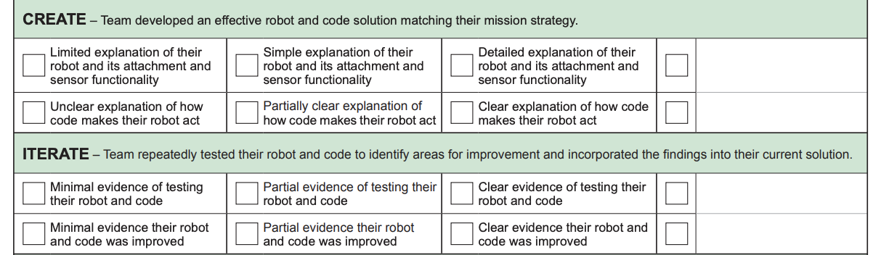
ROBOT DESIGN JUDGING TIPS
You will need to provide clear explanations of the robot design, attachments, and sensors.
Test your robot and present this data to judges to explain how you picked your robot design and how you modified it.

Slide 11

Credits
This tutorial was created by Sanjay Seshan and Arvind Seshan
More lessons at www.ev3lessons.com and www.flltutorials.com
This work is licensed under a Creative Commons Attribution-NonCommercial-ShareAlike 4.0 International License.

